Slide 1
Group 101: Software Engineering
Sprint 1

Slide 2
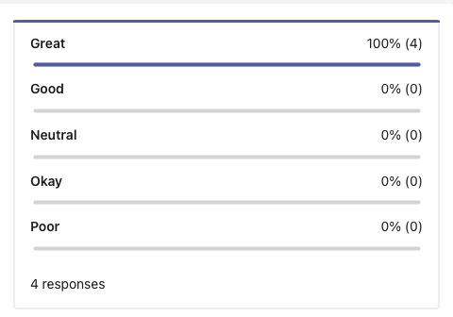
Teams Overall Thoughts

Slide 3
How Did the Sprint Go?
What Went Well
We stayed ahead of time, and were able to finish the bulk of work early in the sprint
Communication
Got the hand of git issues/milestones quickly
Learnt some cool VBA stuff!
Areas of Improvement
More team programming
Assigning issues so we work together more rather than chopping it up per person
Daily standups (text)

Slide 4
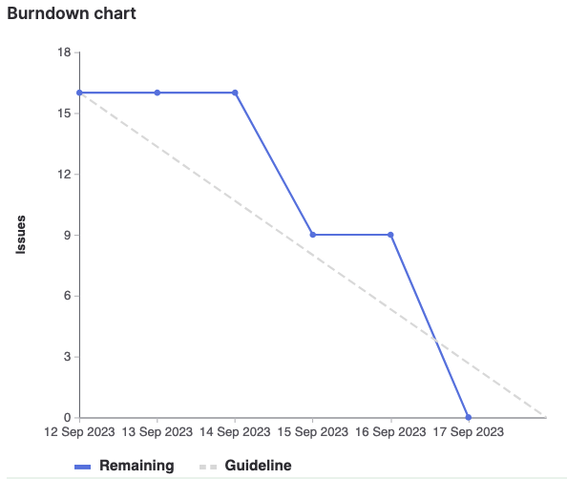
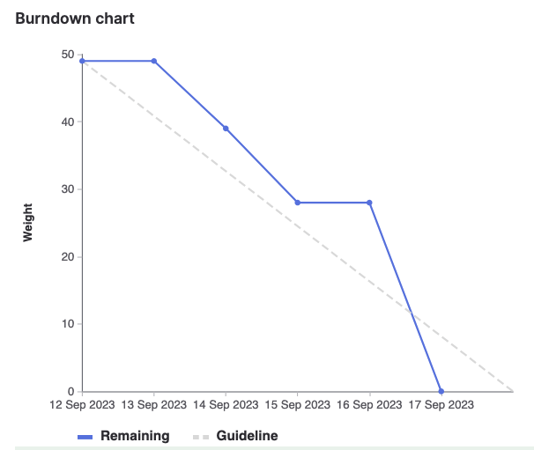
Burndown Chart
Filtered by Issue Filtered by Issue Weight

Slide 5
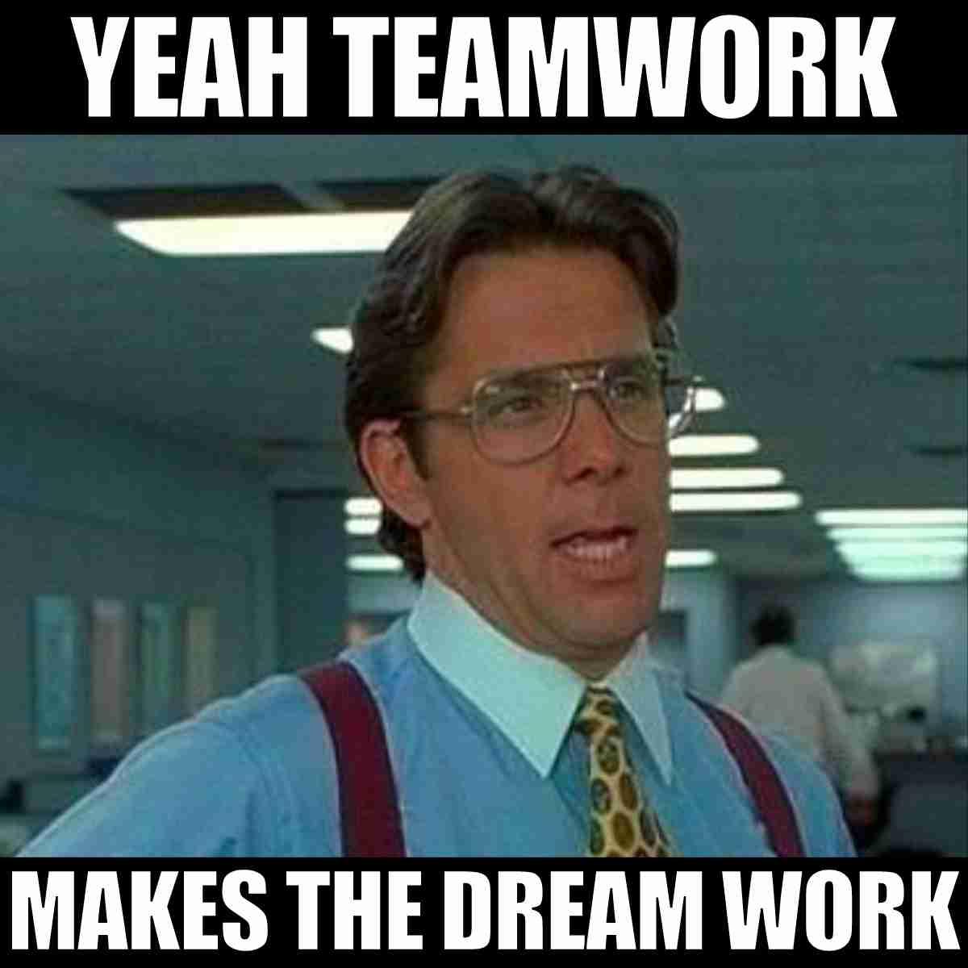
Sara
Work Contributed:
Lead sprint planning /follow up meetings to define sprint goals, prioritize tasks, and assign responsibilities.
Review and merge code contributions, resolving merge conflicts, and ensuring proper branching strategies.
Keep comprehensive meeting minutes during all team meetings, including sprint planning, and team meetings.
Document decisions, action items, and any changes to project scope or requirements.
Maintain up-to-date project documentation, including user stories, technical documentation, and backlogs.
Proposed and explained user stories relevant for the sprint
Highlight of Sprint:
Got to be a sprint lead!
Higher level of respect to all team leads out there .. lol

Slide 6
Maneesh
Work Contributed:
Developed a python script in order to parse the course information from the data file
Extracted relevant information such as course codes, names, and prerequisites.
Proposed and explained user stories relevant for the sprint
Attended team meetings and provided updates
Documented work throughout and thoroughly
Highlight of Sprint:
Simardeep and I figured out how to parse all the edge cases!

Slide 7
Emily
Work Contributed:
Created a command line UI for users in order to implement a search functionality
Developed the functionality of the search
Proposed organizational solutions to data problems
Proposed and explained user stories relevant for the sprint
Attended team meetings and provided updates
Documented work throughout and thoroughly
Highlight of Sprint:
Being a part of the Agile environment!

Slide 8
Simardeep
Work Contributed:
Developed a python script in order to parse the course information from the data file
Extracted relevant information such as course codes, names, and prerequisites.
Proposed and explained user stories relevant for the sprint
Attended team meetings and provided updates
Documented work throughout and thoroughly
Created test cases in order to QA work effectively
Highlight of Sprint:
Maneesh and I figured out how to parse all the edge cases!

Slide 9
Fee Kim
Work Contributed:
Created a command line UI for users in order to implement a search functionality
Developed the functionality of the search
Researched VBA and was able to support the team on that front
Proposed and explained user stories relevant for the sprint
Attended team meetings and provided updates
Documented work throughout and thoroughly
Highlight of Sprint:
Learnt cool VBA coding, and being a part of collaborative environment

Slide 10
DEMO TIME
The make or “break” portion

